Slide 1
Network Layer
Chapter 5
Responsible for getting packets from the source to destination through INTERMEDIATE HOPS
Data link layer: only between two points
The network layer deals with end to end transmission
Should know the topology of the network
Should not overload some routes and underload other routes.
Should deal with different networks

Slide 2
The OSI reference model.

Slide 3
Outline
Design Issues
Routing Algorithms
The optimality principle
Shorted Path Routing
Flooding
Distance vector routing
Link state routing
Hierarchical routing
Broadcast routing
Multicast routing
Congestion Control Algorithms
Quality of Service
Requirements
Techniques for achieving good quality of service
Network Layer of the Internet: An overview

Slide 4
Design Issues
Store-and-forward packet switching
Connectionless service – datagrams
Connection-oriented service – virtual circuits
Comparison of virtual-circuits and datagrams

Slide 5
Store-and-Forward Packet Switching
Components of the network layer
ISP equipment (routers connected by transmission lines)
Host H1 is directly connected to one of the router
Home computer plugged into MODEM
H2 is a LAN, with an office Internet with a router, F, owned and operated by the customer.
The router has a leased line to the ISP’s equipment.
F is not part of ISP, but it runs the same algorithms as the ISP’s routers.
Host sends the packet to the nearest router, which will be forwarded to the next router along the path until it reaches the destination.
The environment of the network layer protocols.

Slide 6
Services Provided to the Transport Layer
Properties of services
The services should be independent of router technology
Transport layer should be shielded from the number, type, and topology of the routers present.
The network addresses made available to transport layer should use a uniform numbering plan across LANs and WANs.
The freedom resulted into two thoughts
First: Network service should be connectionless with SEND PACKET and RECEIVE PACKET and little more.
No ordering and flow control should be done.
Each packet should carry a destination address.
Second: network should be reliable and connection-oriented service based on the experience of telephone service.
Without connections, quality of service is difficult to achieve especially for real-time traffic.
First, connectionless service has dominated.
Later, connection-orient service dominated
Currently, both are widely used.

Slide 7
Connectionless service: datagrams
Packets are injected as datagrams (analogy is telegram).
No advance setup is needed
Network is called datagram network.
H1 handovers long message to transport layer which instructs to deliver packet to P2 on H2. The transport layer runs in H1 (in the operating system). It prepends transport header and handover it to network layer (another procedure)
Network layer breaks it into packets and sends each of them to router A using point-to-point protocol, PPP.
ISP decided where to send packets. It has to take routing decisions.
The algorithm which does routing decisions are called routing algorithm.
In this chapter, we study routing algorithms.
Internet protocol (IP) is the basis of the Internet, individually forwards each packet. 32 bits in IPv4 and 128 bits in IPv6.

Slide 8
Connectionless Service – Datagrams
Packet is forwarded using destination address inside it
Different packets may take different paths
Routing within a datagram network.

Slide 9
Connection-oriented: Virtual Circuits
Idea: Avoid having a new route for every packet.
Establish a connection. When a connection is established, the connection set-up is stored in tables.
The route is used for all traffic flowing over the connection.
H1 established connection 1 with host H2. The first line of A’s table says that if a pack arrives with connection 1 it should be forwarded to C and given connection id as 1.
If H3 also wants to establish a connection to H2, it choses a connection identifier 1 and tells the network to establish a connection.
There is a conflict as A has already used id 1. So, A assigns a different identifier. This process is called label switching. An example of the protocol is MPLS (MultiProtocol label Switching). It wraps packets with 20-bit connection identifier or label.

Slide 10
Connection-Oriented – Virtual Circuits
Packet is forwarded along a virtual circuit using tag inside it
Virtual circuit (VC) is set up ahead of time
Routing within a virtual-circuit network.

Slide 11
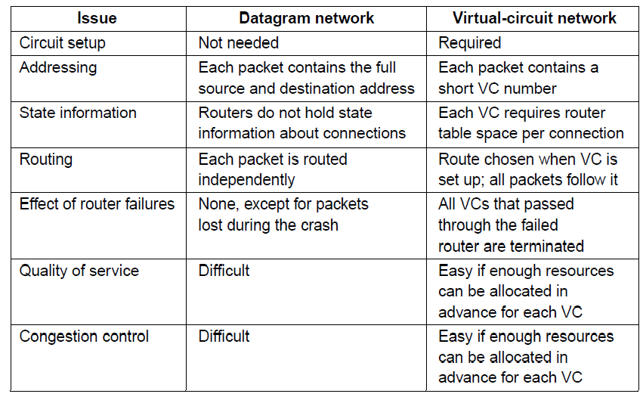
Comparison of Virtual-Circuits & Datagrams

Slide 12
Outline
Design Issues
Routing Algorithms
The optimality principle
Shorted Path Routing
Flooding
Distance vector routing
Link state routing
Hierarchical routing
Broadcast routing
Multicast routing
Congestion Control Algorithms
Quality of Service
Requirements
Techniques for achieving good quality of service
Network Layer of the Internet: An overview

Slide 13
Routing Algorithms
The decision has to be made for every packet as best route may be changed over last time.
Network layer design
Algorithms and data structures
Routing and forwarding
Forwarding: a process which takes each packet and forwards it to outgoing line.
Routing: A process which updates the routing tables.
Routing algorithms play a major role.
Properties of routing algorithm
Correctness, simplicity:
Robustness: it should run for years; hosts fail, routers crash, software fails
Stability: Routing algorithm should converge and reach equilibrium.
fairness, efficiency: Difficult to achieve: For example, in case of high traffic between A and A’, B and B’, C and C’, the traffic between X and X’ will be shut off. So compromise is required.

Slide 14
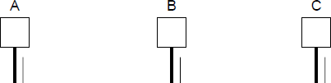
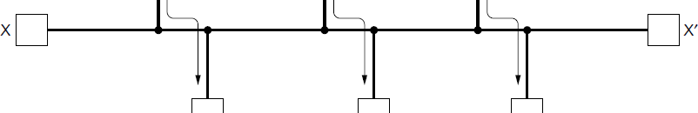
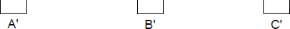
Routing Algorithms (2)
Routing is the process of discovering network paths
Model the network as a graph of nodes and links
Decide what to optimize (e.g., fairness vs efficiency)
Update routes for changes in topology (e.g., failures)
Forwarding is the sending of packets along a path

Slide 15
Routing Algorithms
Nonadaptive algorithms
Decisions do not depend on the state or topology
When the network is booted, routing tables are fixed.
Also called static routing algorithms
Adaptive algorithms
Decisions are based on on the state or topology
Dynamic routing algorithms

Slide 16
Outline
Design Issues
Routing Algorithms
The optimality principle
Shorted Path Routing
Flooding
Distance vector routing
Link state routing
Hierarchical routing
Broadcast routing
Multicast routing
Congestion Control Algorithms
Principles of congestion control
Congestion prevention policies
Congestion control in virtual circuit
Congestion control in data gram subnets
Quality of Service
Requirements
Techniques for achieving good quality of service
Network Layer of the Internet: An overview

Slide 17
The Optimality Principle
Each portion of a best path is also a best path; the union of them to a router is a tree called the sink tree
Best means fewest hops in the example
Set of all optimal routes from all sources to a given destination form a sink tree
Goal of routing algorithm: discover and use sink trees for all the routers.
The optimality principle acts as a Benchmark for comparison
(a) A network. (b) A sink tree for router B.

Slide 18
Outline
Design Issues
Routing Algorithms
The optimality principle
Shorted Path Routing
Flooding
Distance vector routing
Link state routing
Hierarchical routing
Broadcast routing
Multicast routing
Congestion Control Algorithms
Principles of congestion control
Congestion prevention policies
Congestion control in virtual circuit
Congestion control in data gram subnets
Quality of Service
Requirements
Techniques for achieving good quality of service
Network Layer of the Internet: An overview

Slide 19
Shortest Path Algorithm (1)
Dijkstra’s algorithm computes a sink tree on the graph:
Each link is assigned a non-negative weight/distance
Shortest path is the one with lowest total weight
Using weights of 1 gives paths with fewest hops
Algorithm:
Start with sink, set distance at other nodes to infinity
Relax distance to other nodes
Pick the lowest distance node, add it to sink tree
Repeat until all nodes are in the sink tree

Slide 20
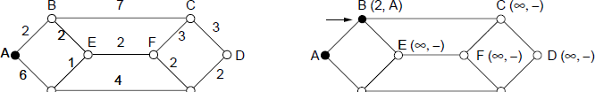
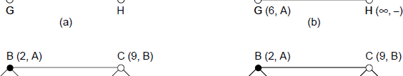
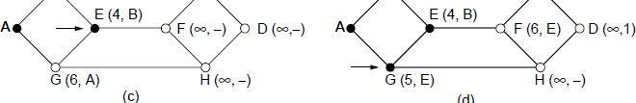
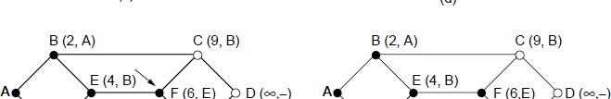
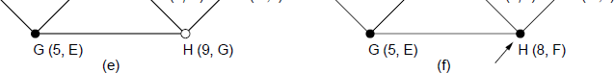
Shortest Path Algorithm (2)
A network and first five steps in computing the shortest paths from A to D. Pink arrows show the sink tree so far.

Slide 21
Outline
Design Issues
Routing Algorithms
The optimality principle
Shorted Path Routing
Flooding
Distance vector routing
Link state routing
Hierarchical routing
Broadcast routing
Multicast routing
Congestion Control Algorithms
Principles of congestion control
Congestion prevention policies
Congestion control in virtual circuit
Congestion control in data gram subnets
Quality of Service
Requirements
Techniques for achieving good quality of service
Network Layer of the Internet: An overview

Slide 22
Flooding
A simple method to send a packet to all network nodes
Each node floods a new packet received on an incoming link by sending it out all of the other links
Generates vast numbers of duplicate packets.
Method 1:
Flooding with an hop count: Put hop counter and decrement hop counter for each node.
-ve: generates exponential number of duplicate pockets
Method 2
Track the packets. Stop, if it is already flooded, i.e., avoid sending second time.
Put a sequence number for each source in the packet. Maintain the list at each node.

Slide 23
Flooding
Flooding is not practical, but has several advantages
It ensures that packet reaches every node.
Flooding is tremendously robust.
Even if large number of routers are damaged, the packet reaches the destination.
Flooding produces shorter delay
Flooding can be used to compare other algorithms.

Slide 24
Outline
Design Issues
Routing Algorithms
The optimality principle
Shorted Path Routing
Flooding
Distance vector routing
Link state routing
Hierarchical routing
Broadcast routing
Multicast routing
Congestion Control Algorithms
Principles of congestion control
Congestion prevention policies
Congestion control in virtual circuit
Congestion control in data gram subnets
Quality of Service
Requirements
Techniques for achieving good quality of service
Network Layer of the Internet: An overview

Slide 25
Distance Vector Routing (1)
Dynamic
Distance vector is a distributed routing algorithm
Shortest path computation is split across nodes
Each router maintains the table giving the best known distance to each destination
Bellman-Ford Algorithm (followed in ARPANET):
Each node knows the distance of links to its neighbors
Each node advertises vector of lowest known distances to all neighbors
Each node uses received vectors to update its own
Repeat periodically

Slide 26
Distance Vector Routing (1)
Once every T sec, each router sends to each neighbor a list of estimated delays to the destination. It also receives similar list from its neighbors and calculated the new routing table.
Example
Four columns show the delay vectors received from neighbors. A claims to have a 12 msec delay to B, 25msec delay to C, and 40 sec delay to D and so on.
Suppose, J has measured or estimated its delay to its neighbors A, I,H, and K as 8, 10, 12, and 6 respectively.
J computes time delay to G as follows.
One route: J,A,..G = 8 (JA) +18 (AG)=26
Second route: J I ..G=41(31+10)
Third route: J H..G= 18(6+12)
Fourth route: JK..G=37 (31+6)
The best route is 18.

Slide 27
Distance Vector Routing (2)
(a)A network. (b)Input from A, I, H, K, and the new routing table for J.

Slide 28
The Count-to-Infinity Problem
Convergence: Though it converges to correct answer, it converges slowly.
Responds rapidly to good news, but very slowly to bad news.
In Figure (a) shows how good news spreads quickly.
A comes-up and B lears that the delay to B is zeo
Figure (b) demonstrates count to infinity problem.
Suppose node A is down. As per B, it can reach A with 2 hops….
The count-to-infinity problem.

Slide 29
Outline
Design Issues
Routing Algorithms
The optimality principle
Shorted Path Routing
Flooding
Distance vector routing
Link state routing
Hierarchical routing
Broadcast routing
Multicast routing
Congestion Control Algorithms
Principles of congestion control
Congestion prevention policies
Congestion control in virtual circuit
Congestion control in data gram subnets
Quality of Service
Requirements
Techniques for achieving good quality of service
Network Layer of the Internet: An overview

Slide 30
Link State Routing (1)
Distance vector routing is replaced by link state routing.
More computation but simpler dynamics
Widely used in the Internet
Algorithm: Each router
Discovers its neighbors and learn their network addresses.
After booting, node sends HELLO packet to each point-to-point line.
Set the distance or cost metric to each of its neighbors
Construct a packet with the learning.
Send this packet and receive packet from all other routers.
Compute the shortest path to every other router

Slide 31
Link State Routing (2) – LSPs
LSP (Link State Packet) for a node lists neighbors and weights of links to reach them
For each neighbour, the delay to that neighbour is given.
(a) A network. (b) The link state packets for this network.

Slide 32
Link State Routing (3) – Reliable Flooding
Seq. number and age are used for reliable flooding
New LSPs are acknowledged on the lines they are received and sent on all other lines
Example shows the LSP database at router B
Once the router receives link states from all nodes,it can construct entire subnet graph.
The packet buffer for router B in Fig. 5-12(a).

Slide 33
Outline
Design Issues
Routing Algorithms
The optimality principle
Shorted Path Routing
Flooding
Distance vector routing
Link state routing
Hierarchical routing
Broadcast routing
Multicast routing
Congestion Control Algorithms
Quality of Service
Requirements
Techniques for achieving good quality of service
Network Layer of the Internet: An overview

Slide 34
Hierarchical Routing
As network grows, the router tables grow proportionately.
More memory and CPU time
More bandwidth
After certain limit, it is not possible to send routing table to every other router.
Hierarchical routing
Routers are divided into regions.
Each router knows how to route packets to other routers within the region.
Hierarchy may consists of multiple levels.

Slide 35
Hierarchical Routing
Hierarchical routing reduces the work of route computation but may result in slightly longer paths than flat routing
Hierarchical routing.

Slide 36
Outline
Design Issues
Routing Algorithms
The optimality principle
Shorted Path Routing
Flooding
Distance vector routing
Link state routing
Hierarchical routing
Broadcast routing
Multicast routing
Congestion Control Algorithms
Principles of congestion control
Congestion prevention policies
Congestion control in virtual circuit
Congestion control in data gram subnets
Quality of Service
Requirements
Techniques for achieving good quality of service
Network Layer of the Internet: An overview

Slide 37
Broadcast routing
Broadcast sends a packet to all nodes
Simple algorithm: send the packet to each destination.
It is slow and wastes bandwidth
Source should have a list of all destinations.
Multi-destination routing
Each packet contains a list of destinations or a bitmap indicating desired destinations.
The router generated new copy of the packet for each output line and includes in the packet only those destinations which are on the line.
After sufficient number of hops the packet will have only one destination
Bandwidth is used efficiently.

Slide 38
Broadcast routing
Flooding is another broadcast technique
Reverse path forwarding (figure (c))
When a broadcast packet arrives to the router, the router checks to see if the packet arrived on the link that is normally used for sending packets toward the source of the broadcast.
If so, there is a chance that broadcast packet might have followed the excellent route.
The router forwards the packet to all links except incoming links.
If the packet arrives from other link than the preferred one, the pack is discarded as a likely duplicate.
After 5 hops, with 24 packets broadcasting terminates.
+ve: easy to implement and efficient; no sequence numbers are required.
Spanning tree algorithm: figure (b)
Minimum of 14 packets
-ve: each router should have knowledge of spanning tree

Slide 39
Broadcast Routing
Broadcast sends a packet to all nodes
RPF (Reverse Path Forwarding): send broadcast received on the link to the source out all remaining links
Alternatively, can build and use sink trees at all nodes
Reverse path forwarding. (a) A network. (b) Sink tree for router I. (c) The tree built by reverse path forwarding from I.

Slide 40
Outline
Design Issues
Routing Algorithms
The optimality principle
Shorted Path Routing
Flooding
Distance vector routing
Link state routing
Hierarchical routing
Broadcast routing
Multicast routing
Congestion Control Algorithms
Principles of congestion control
Congestion prevention policies
Congestion control in virtual circuit
Congestion control in data gram subnets
Quality of Service
Requirements
Techniques for achieving good quality of service
Network Layer of the Internet: An overview

Slide 41
Multicast Routing (1) – Dense Case
Send a message to well-defined group, numerically large by small than the size of the network
Example: live video
Multicast sends to a subset of the nodes called a group
Routing algorithm: multicast routing
All multicasting schemes require a way to create and destroy groups and identify which routers are the members of the group.

Slide 42
Multicast Routing (1) – Dense Case
If the group is dense, employ broadcasting
Remove those nodes which are not the members in the spanning tree.
Multicasting spanning tree
Use link state routing to identify the nodes.
A network. (b) A spanning tree for the leftmost router.
(c) A multicast tree for group 1. (d) A multicast tree for group 2.

Slide 43
Multicast Routing (2) – Sparse Case
CBT (Core-Based Tree) uses a single tree to multicast
All the members agree on a tree.
Tree is the sink tree from core node to group members
Multicast heads to the core until it reaches the CBT
(a) Core-based tree for group 1. (b) Sending to group 1.

Slide 44
Anycast Routing
Anycast sends a packet to one (nearest) group member
Used for time of the day, DNS service
Falls out of regular routing with a node in many places
(a) Anycast routes to group 1. (b) Topology seen by the routing protocol.

Slide 45
Outline
Design Issues
Routing Algorithms
The optimality principle
Shorted Path Routing
Flooding
Distance vector routing
Link state routing
Hierarchical routing
Broadcast routing
Multicast routing
Congestion Control Algorithms
Quality of Service
Requirements
Techniques for achieving good quality of service
Network Layer of the Internet: An overview

Slide 46
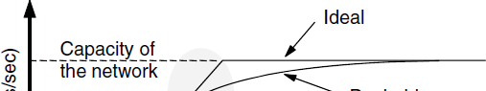

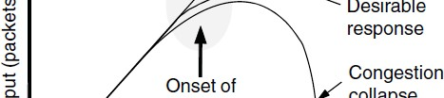

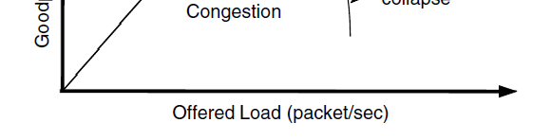
Congestion Control (1)
Congestion is a situation: Too many packets present in the network causes network delay and loss
Both network and transport layers share the responsibility to control congestion.
Effective way is to reduce the load at the transport layer.
Goodput (=useful packets) trails offered load

Slide 47
Congestion Control (2)
Network experiences a congestion collapse
If routers will have infinite memory, congestion gets worse
Packets gets timed out.
Difference between congestion control and flow control
Congestion control is related to whole network. Involves the behavior of all the hosts and routers.
Flow control relates to the traffic between a particular sender and a particular receiver.
Best method is to get host a “slow down”.

Slide 48
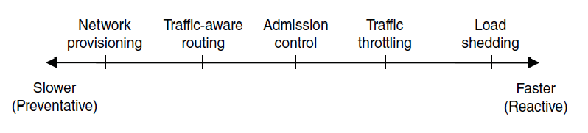
Congestion Control (3) – Approaches
Network must do its best with the offered load
Different approaches at different timescales
Nodes should also reduce offered load (Transport)

Slide 49
Congestion Control (1)
Handling congestion is the responsibility of the Network and Transport layers working together
− We look at the Network portion here
Traffic-aware routing »
Admission control »
Traffic throttling »
Load shedding »

Slide 50
Network provisioning
Links and routers that are heavily utilized are upgraded at the earliest opportunity.
By considering short-term and long-term traffic trends.

Slide 51
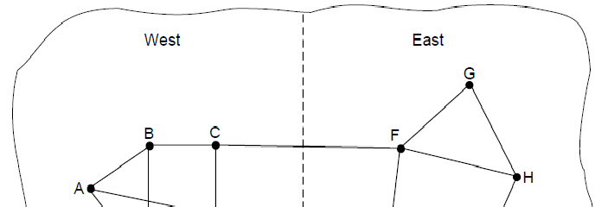

Traffic-Aware Routing
Choose routes depending on traffic, not just topology
Link weight is a function of the link bandwidth, propagation delay, measured load (average queuing delay)
Routing tables are updated accordingly.
E.g., use EI for West-to-East traffic if CF is loaded
-ve: routing tables may oscillate wildly leading to erratic routing and other problems

Slide 52
Admission Control
Idea: do not set up a new virtual circuit unless the network can carry the added traffic without becoming congested.
Attempt to set up a virtual circuit may fail.
Example: telephone system
Issue is handling bursty traffic
Video is easy to handle
Traffic due to web browsing is very bursty
Admission control can be combined with traffic ware routing
Redraw the network topology based on information about congested routers.
For example, normally connection between router A and B passes through one of the congested routers. Based on the information, we can redraw the network.

Slide 53
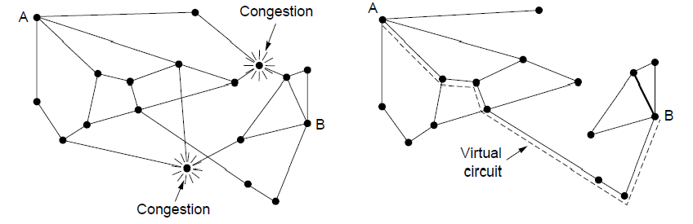
Admission Control
Admission control allows a new traffic load only if the network has sufficient capacity, e.g., with virtual circuits
Can combine with looking for an uncongested route
Network with some congested nodes
Uncongested portion and route AB around congestion

Slide 54
Traffic Throttling
When the congestion is imminent, network should tell the senders to throttle back their transmissions and slow down.
Congestion avoidance
Congested routers signal hosts to slow down traffic for Datagram networks and virtual circuit networks.
Two problems have to be solved for each approach
First: router must determine when congestion is approaching, before it has arrived.
Queuing delay captures congestion experienced by packets
Second: routers must send timely feedback to the senders that are causing congestion.
ECN (Explicit Congestion Notification) marks packets and receiver returns signal to sender

Slide 55
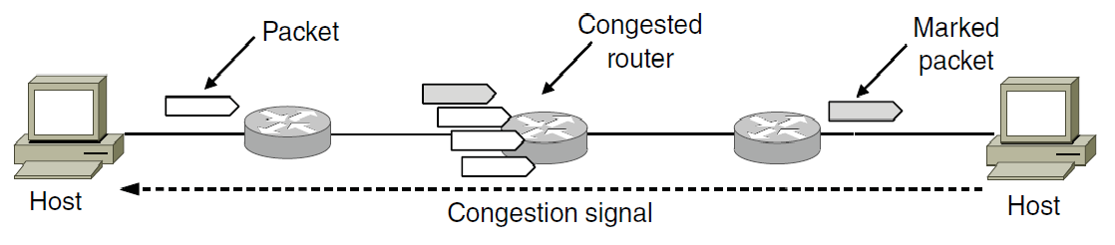
Traffic Throttling: feedback mechanisms
Choke packets
Router selects the congested packet and sends the choked packet back to source host.
When a source gets the choked packet, it is supposed to reduce the 50% of traffic.
Explicit congestion notification (ECN)
The router can tag any packet it forwards to signal that it is experiencing a congestion.
When a network delivers a packet, the received can inform the sender about congestion through ack. message. The design is called Explicit Congestion Notification (ECN).

Slide 56
Traffic Throttling: feedback mechanisms
With ECN method, many new packets may be transmitted after the congestion.
Alternative approach: Hop-by-Hop Backpressure
Have the choke packet take effect at every hop it passes through
Whenever a packet reaches F, F is required to reduce the flow to D.
Example:
As soon as choke packet reaches F, F is required to reduce the flow to D.
It gives the D immediate relief
Similarly when a choke packet reaches E, E has to reduce the flow to F.
(a) A choke packet that affects only the source. (b) A choke packet that affects each hop it passes through.

Slide 57
Load Shedding (1)
When all else fails, network will drop packets (shed load)
When routers are being inundated by packets that they can not handle, they just throw them away.
Key question
Which packets to drop?
File transfer: old packet is important
WINE policy
Realtime traffic: new packet is important
MILK policy
Application must mark the importance on the packets.

Slide 58
Load Shedding (1)
Random Early Detection
Routers maintain a running average of queue length
When an average queue length exceeds, router starts dropping the packets at random.
Fast senders will have more packet drop
Sender will notice the loss as there are no ack. and slow down
Better performance.

Slide 59
Outline
Congestion Control Algorithms
Quality of Service
Requirements
Techniques for achieving good quality of service
Network Layer of the Internet: An overview
Design Issues
Routing Algorithms
The optimality principle
Shorted Path Routing
Flooding
Distance vector routing
Link state routing
Hierarchical routing
Broadcast routing
Multicast routing

Slide 60
Quality of Service
So far, we have made effort to improve network performance
However, some applications require stronger performance guarantees.
Example: Multimedia applications:
We will focus of providing network performance with a sharp focus on providing quality of service.
One solution is overprovisioning
More money is required
With quality of service mechanisms, the network can honor performance guarantees at the cost of turning down some requests.
Issues
What applications need from the network?
How to regulate the traffic that enters the network?
How to reserve the resources at routers to guarantee performance?
Whether the network can safely accept more traffic
No single technique deals efficiently all these issues..

Slide 61
Quality of Service
Application requirements »
Traffic shaping »
Packet scheduling »
Admission control »
Integrated services »
Differentiated services »

Slide 62
Parameters Defining QoS
Throughput/bandwidth - the total amount of work completed during a specific time interval.
Delay - the elapsed time from when a request is first submitted to and when the desired result is produced.
Jitter – Variation in packet arrival times
Due to lost frames.
Not acceptable for continuous media applications
Random variation of transmission time
Different packets will have different delay
Disturbs realtime audio and video applications
Reliability/loss - how errors are handled during transmission and processing of continuous media.

Slide 63
Application Requirements (1)
Different applications care about different properties
We want all applications to get what they need
.
Application | Bandwidth | Delay | Jitter | Loss
Email | Low | Low | Low | Medium
File sharing | High | Low | Low | Medium
Web access | Medium | Medium | Low | Medium
Remote login | Low | Medium | Medium | Medium
Audio on demand | Low | Low | High | Low
Video on demand | High | Low | High | Low
Telephony | Low | High | High | Low
Videoconferencing | High | High | High | Low
Stringency of applications' quality-of-service requirements.

Slide 64
Application Requirements (2)
Bandwidth:
E-mail, audio, remote login not need much bandwidth. But file sharing and video in all forms need high bandwidth.
Delay:
File transfer, email, audio, and video are not delay sensitive. That is if the packets are delayed uniformly across all by a few seconds, no harm is done. So, playing audio or video files from a server does not require low delay.
But, interactive applications, web access surfing and remote login are more delay sensitive. Telephony, and video conferencing are strictly delay sensitive
Jitter
E-mail, file sharing and web access not sensitive to irregular arrival of packets.
Remote login is sensitive
Video and audio are extremely sensitive to Jitter
Loss:
E-mail, file sharing, web access and remote login have more stringent requirements on loss and bits should be delivered correctly.
Audio and video applications tolerate lost packets.
People do not notice short pauses or skipped frames.
.

Slide 65
Application Requirements (3)
Network support different categories of QoS
Constant bit rate (telephony)
Simulate a wire by providing uniform bandwidth and a uniform delay
Real-time variable bit rate (e.g., compressed video conferencing)
Sending a complex frame requires many bits, where a shot of white ball requires less bits.
Non-real-time variable bit rate (e.g., watching a movie on demand)
Buffering can be used
Available bit rate (e.g., file transfer)
-Use the available bandwidth.
.

Slide 66
Application Requirements (2)
Network provides service with different kinds of QoS (Quality of Service) to meet application requirements
Network Service | Application
Constant bit rate | Telephony
Real-time variable bit rate | Videoconferencing
Non-real-time variable bit rate | Streaming a movie
Available bit rate | File transfer
Example of QoS categories from ATM networks

Slide 67
Traffic Shaping (1)
We must know that traffic is being guaranteed
However, traffic in data is BURSTY!
Bursts in the traffic are difficult to handle than constant rate traffic as they can fill the buffers and cause packets to be lost.
Traffic shaping
regulates the average rate and burstiness
Monitoring traffic flow is called “Traffic policing”
Traffic shaping and Traffic policing are important for real-time data (audio and video).

Slide 68
Leaky bucket algorithm
Sliding window controls the data to be transmitted.
Leaky bucket algorithm
Imagine a bucket with a small hole at the bottom.
No matter the rate the data enters, the outflow is constant.
Once the bucket is full with a capacity B, any additional water splits over the sides and lost.
Algorithm
Each host is connected to the network containing a leaky bucket.
If the packet arrives when the bucket is full, it is queued until enough water leaks out to hold it or be discarded.

Slide 69
Leaky and Token buckets
(a) Shaping packets. (b) A leaky bucket. (c) A token bucket.

Slide 70
Token bucket algorithm
Imagine a bucket that is being filled. A tap is running at the rate R and the bucket has a capacity of B, as before.
To send a packet, we must able to take water or tokens as out of bucket.
If the bucket is empty, we must wait till tokens arrive.
No more than a fixed number of tokens can accumulate in the bucket.
Both leaky and token bucket algorithms smoothen the traffic by limiting the rate of flow.
Leaky and token buckets are easy to implement.
Comparison: As compared to Leaky Bucket, token bucket algorithm is flexible, allows busty traffic (variable transmission rate) as several tokens can be used at a time.

Slide 71
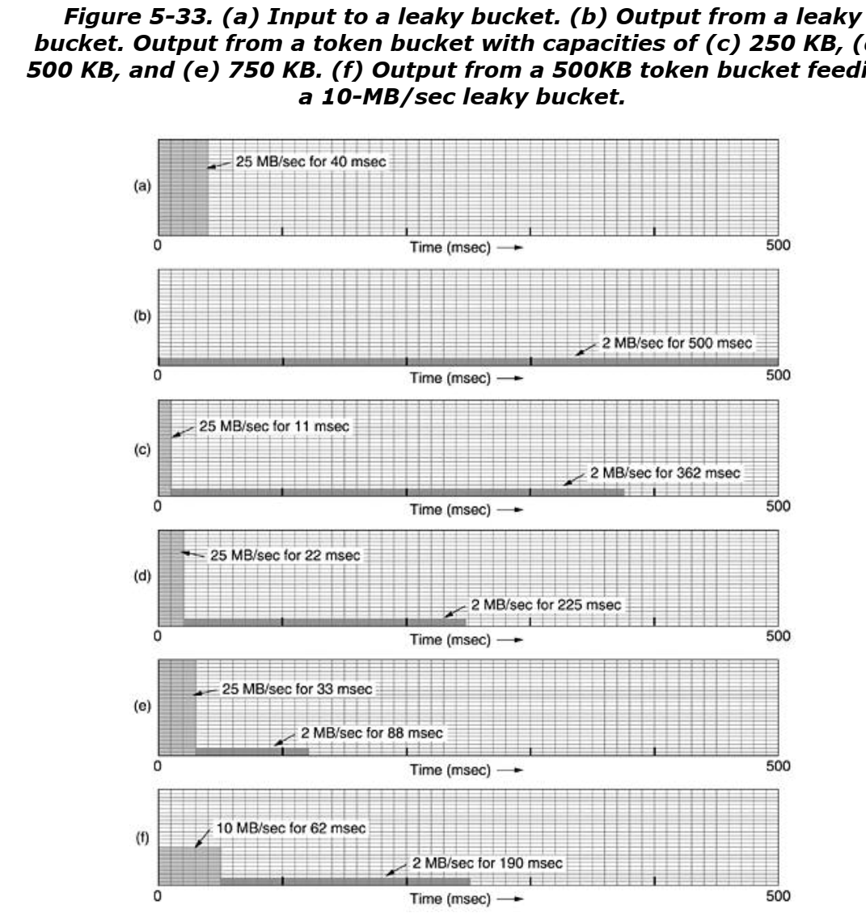
Traffic Shaping (3)

Slide 72
In Fig. 5-33(a) we see the input to the leaky bucket running at 25 MB/sec for 40 msec. In Fig. 5-33(b) we see the output draining out at a uniform rate of 2 MB/sec for 500 msec.
The token bucket does is allow bursts, but up to a regulated maximum length.
In Fig. 5-33(c), we have a token bucket with a capacity of 250 KB.
Tokens arrive at a rate allowing output at 2 MB/sec. Assuming the token bucket is full when the 1-MB burst arrives, the bucket can drain at the full 25 MB/sec for about 11 msec. Then it has to cut back to 2 MB/sec until the entire input burst has been sent.

Slide 73
Packet Scheduling (1)
Regulating the traffic is OK.
However, to provide performance guarantee, we must reserve sufficient resources along the route for performance guarantee.
Packet scheduling algorithms
Allocate router resources among the packets of a flow and between competing flows.
Three kinds of resources are reserved
Bandwidth
If flow requires 1Mbps and bandwidth is 2Mbps, one should not try to get three flows through a line.
Buffer space
Purpose of buffer is to absorb the small bursts. To have quality of service, some buffers are reserved for a specific flow.
CPU cycles
Making sure that CPU is not loaded

Slide 74
Packet Scheduling (1)
FIFO: First-Come-First-Serve
Drop newly arrived packets
Tail drop behavior
Simple to implement
Not good for achieving quality of service in case of multiple flows
Fair queuing round-robin
Routers have separate queues, one for each flow.
When line becomes idle, the router scans queues in a round robin fashion.
Round-robin fair queueing.

Slide 75
Packet Scheduling (2)
Byte-byte round robin.
Compute the virtual time that is the number of round at which each packet would finish being sent.
It gives all hosts the same priority
Weighted Fair Scheduling (WFG)
Number of bytes per round will be weight (W) of the flow.
Fi=max(Ai,Fi-1)+Li/W
Ai is the arrival time, Fi is the finish time, Li is the length of the packet
(a) Weighted Fair Queueing. (b) Finishing times for the packets.

Slide 76
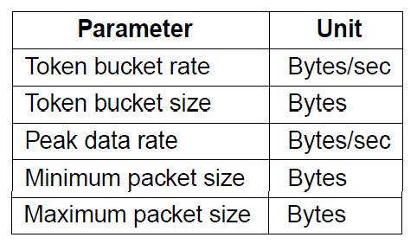
Admission Control (1)
Admission control takes a traffic flow specification and decides whether the network can carry it
Sets up packet scheduling to meet QoS
Example flow specification

Slide 77
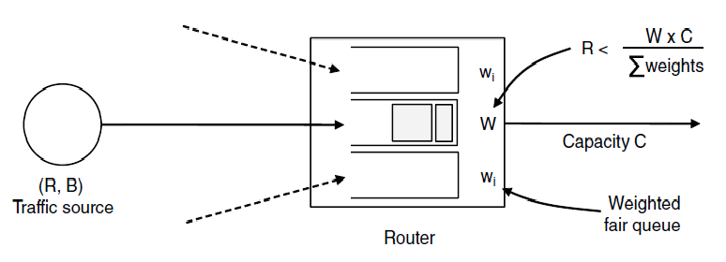
Admission Control (2)
Construction to guarantee bandwidth B and delay D:
Shape traffic source to a (R, B) token bucket
Run WFQ (Waited Fair Queue) with weight W / all weights > R/capacity
Holds for all traffic patterns, all topologies

Slide 78
Outline
Design Issues
Routing Algorithms
The optimality principle
Shorted Path Routing
Flooding
Distance vector routing
Link state routing
Hierarchical routing
Broadcast routing
Multicast routing
Congestion Control Algorithms
Principles of congestion control
Congestion prevention policies
Congestion control in virtual circuit
Congestion control in data gram subnets
Quality of Service
Network Layer of the Internet: An overview

Slide 79
Network Layer in the Internet (1)
IP Version 4 »
IP Addresses »
IP Version 6 »
Internet Control Protocols »
Label Switching and MPLS »
OSPF—An Interior Gateway Routing Protocol »
BGP—The Exterior Gateway Routing Protocol »
Internet Multicasting »
Mobile IP »

Slide 80
Network Layer in the Internet (2)
IP has been shaped by guiding principles:
Make sure it works
Keep it simple
Make clear choices
Exploit modularity
Expect heterogeneity
Avoid static options and parameters
Look for good design (not perfect)
Strict sending, tolerant receiving
Think about scalability
Consider performance and cost

Slide 81
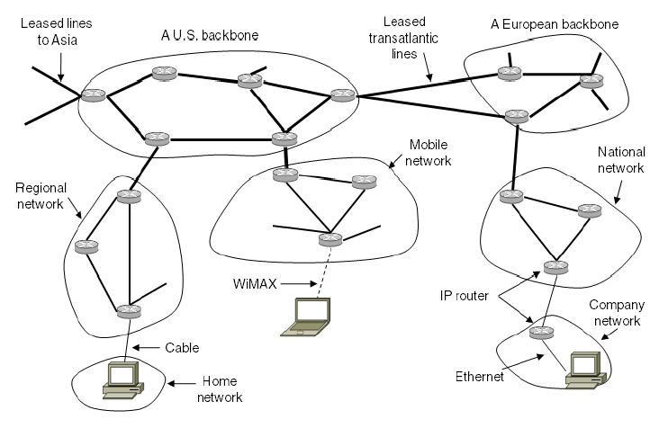
Network Layer in the Internet (3)
Internet is an interconnected collection of many networks that is held together by the IP protocol

Slide 82
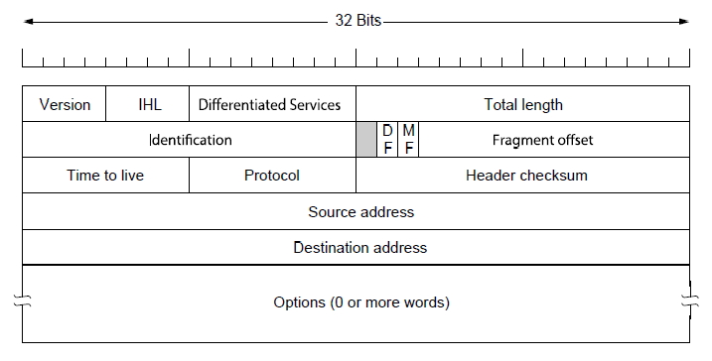
IP Version 4 Protocol (1)
IPv4 (Internet Protocol) header is carried on all packets and has fields for the key parts of the protocol:

Slide 83
IP Version 4 Protocol (1)
Version filed
IHL: header length
Differentiated services: type of service
Total length: every thing in the datagram
Identification field: which packet the newly arrived fragment belong to
All the fragments of the same packet have the same identification code.
Next field: not defined
DF: do not fragment
MF more fragments
It is set to know whether all the fragments of datagram have arrived.
Fragment offset
Where in the current packet this packet belongs
TtL: Time to live
To limit packet life time
Decremented after each hop
Protocol: UDP or TCP
Header checksum
Source and destination address indicate the IP address of source and destination
Options field
For other ideas
Security
Strict route
Set of routes
Lose routes
Set of routes

Slide 84
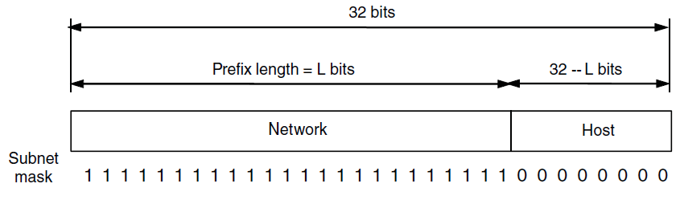
IP Addresses (1) – Prefixes
Addresses are allocated in blocks called prefixes
Prefix is determined by the network portion
Has 2^{L} addresses aligned on 2^{L} boundary
Written address/length, e.g., 18.0.31.0/24

Slide 85
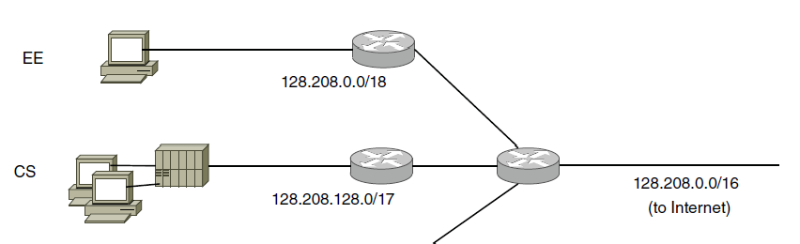
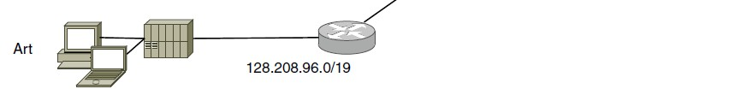
IP Addresses (2) – Subnets
Subnetting splits up IP prefix to help with management
Looks like a single prefix outside the network
Network address <Network bits, subnet bits, host bits>
ISP gives network a single prefix
Network divides it into subnets internally

Slide 86

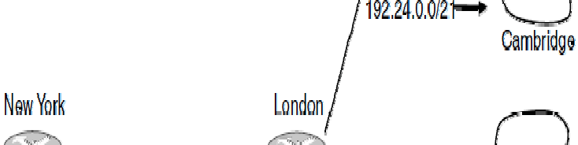
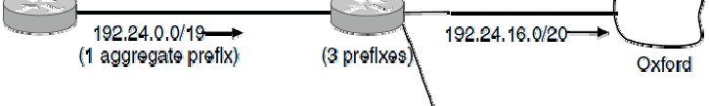
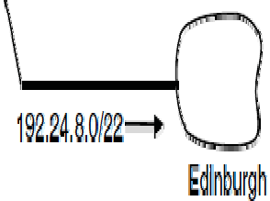
IP Addresses (3) – Aggregation
Aggregation joins multiple IP prefixes into a single larger prefix to reduce routing table size
ISP advertises
a single prefix
ISP customers have different prefixes

Slide 87
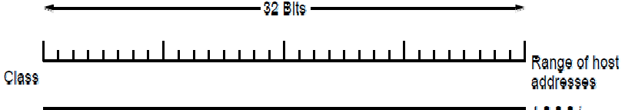
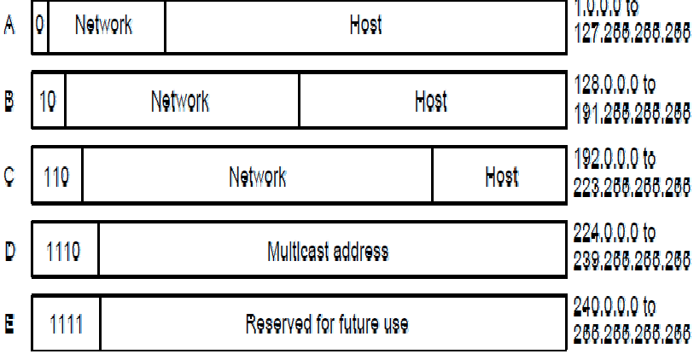
IP Addresses (5) – Classful Addresing
Old addresses came in blocks of fixed size (A, B, C)
Carries size as part of address, but lacks flexibility
Called classful (vs. classless) addressing

Slide 88
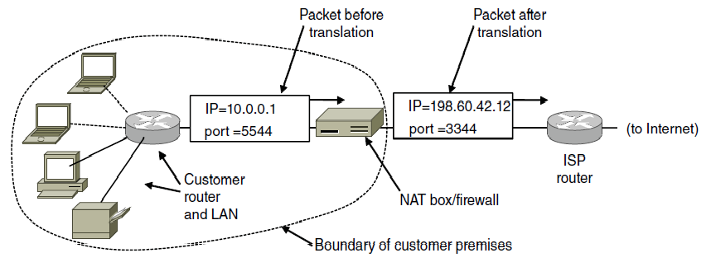
IP Addresses (6) – NAT
NAT (Network Address Translation) box maps one external IP address to many internal IP addresses
Uses TCP/UDP port to tell connections apart
Violates layering; very common in homes, etc.

Slide 89
Internet Control Protocols (1)
IP works with the help of several control protocols:
ICMP (Internet Control Message Protocol ) is a companion to IP that returns error info
Required, and used in many ways, e.g., for traceroute
ARP (Address Resolution Protocol) finds Ethernet address of a local IP address
Glue that is needed to send any IP packets
Host queries an address and the owner replies
DHCP (Dynamic Host Configuration Protocol) assigns a local IP address to a host
Gets host started by automatically configuring it
Host sends request to server, which grants a lease

Slide 90
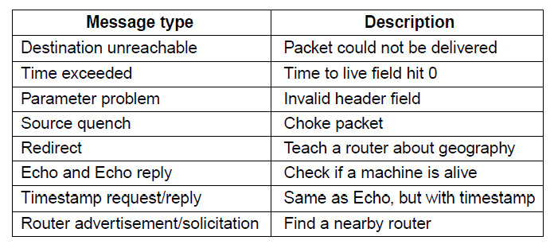
Internet Control Protocols (2)
Main ICMP (Internet Control Message Protocol) types:

Slide 91
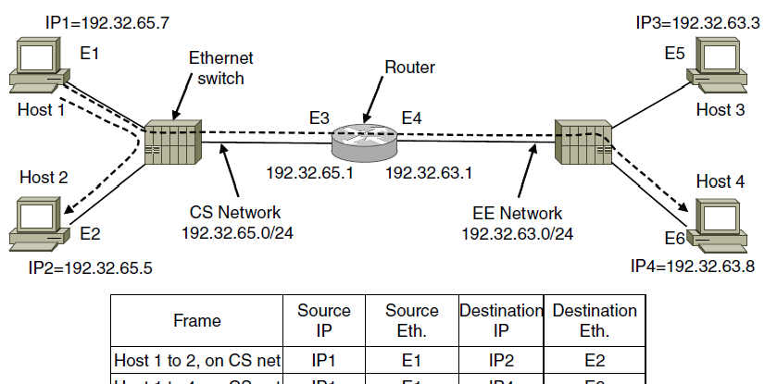


Internet Control Protocols (3)
ARP (Address Resolution Protocol) lets nodes find target Ethernet addresses [pink] from their IP addresses

Slide 92
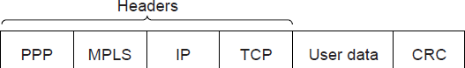

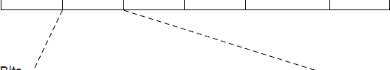

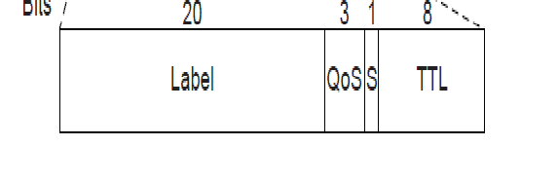
Label Switching and MPLS (1)
MPLS (Multi-Protocol Label Switching) sends packets along established paths; ISPs can use for QoS
Path indicated with label below the IP layer

Slide 93
About IPv6
Support billions of hosts, even with inefficient address space allocation.
Address contains 16 bytes
Notation:
Written as eight groups of four hexadecimal digits with colons between the groups
Example: 8000:0000:0000:0000:0123:4567:89AB:CDEF
Optimizations:
First, leading zeros within a group can be omitted, so 0123 can be written as 123.
Second, one or more groups of 16 zero bits can be replaced by a pair of colons.
The above address now becomes 8000::123:4567:89AB:CDEF
IPv4 addresses can be written as a pair of colons and an old dotted decimal number
Example ::192.31.20.46

Slide 94
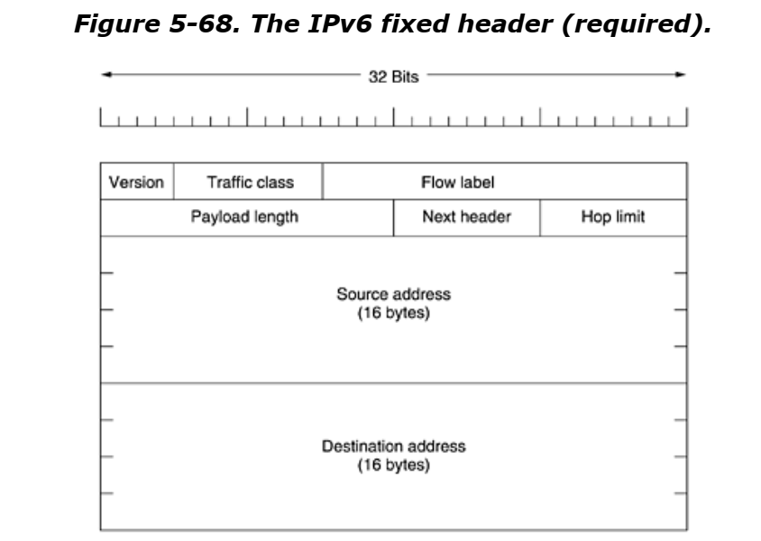

Slide 95
Chapter 5
End

